Slide 1
Deep Learning CS60010
Abir Das
Assistant Professor
Computer Science and Engineering Department
Indian Institute of Technology Kharagpur
http://cse.iitkgp.ac.in/~adas/

Slide 2
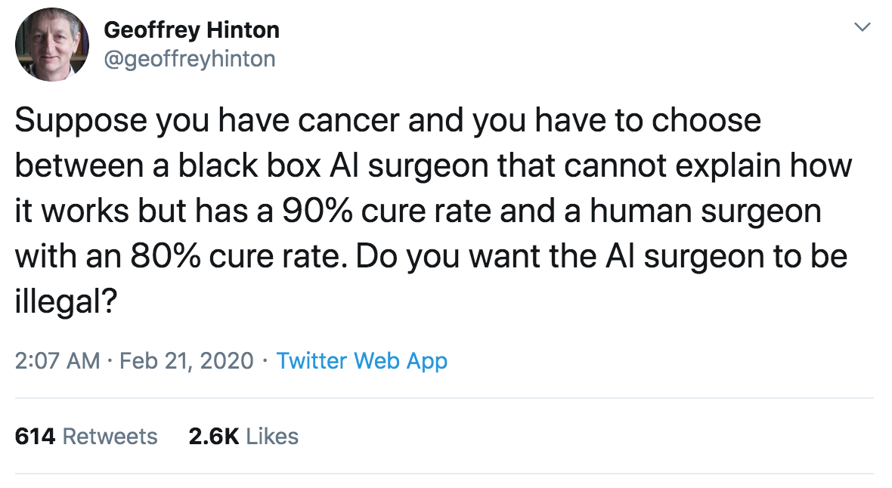
What has a Forefather to Say about Explainability

Slide 3
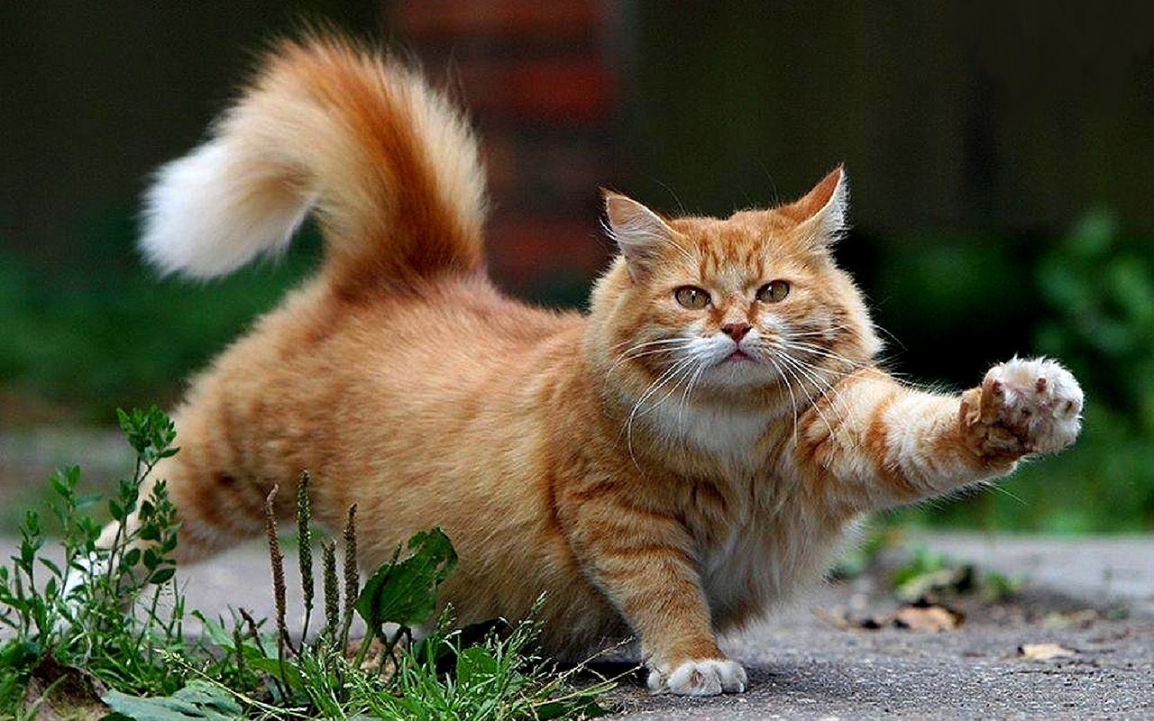
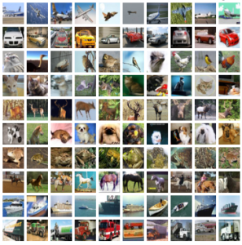
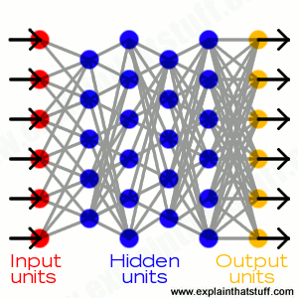



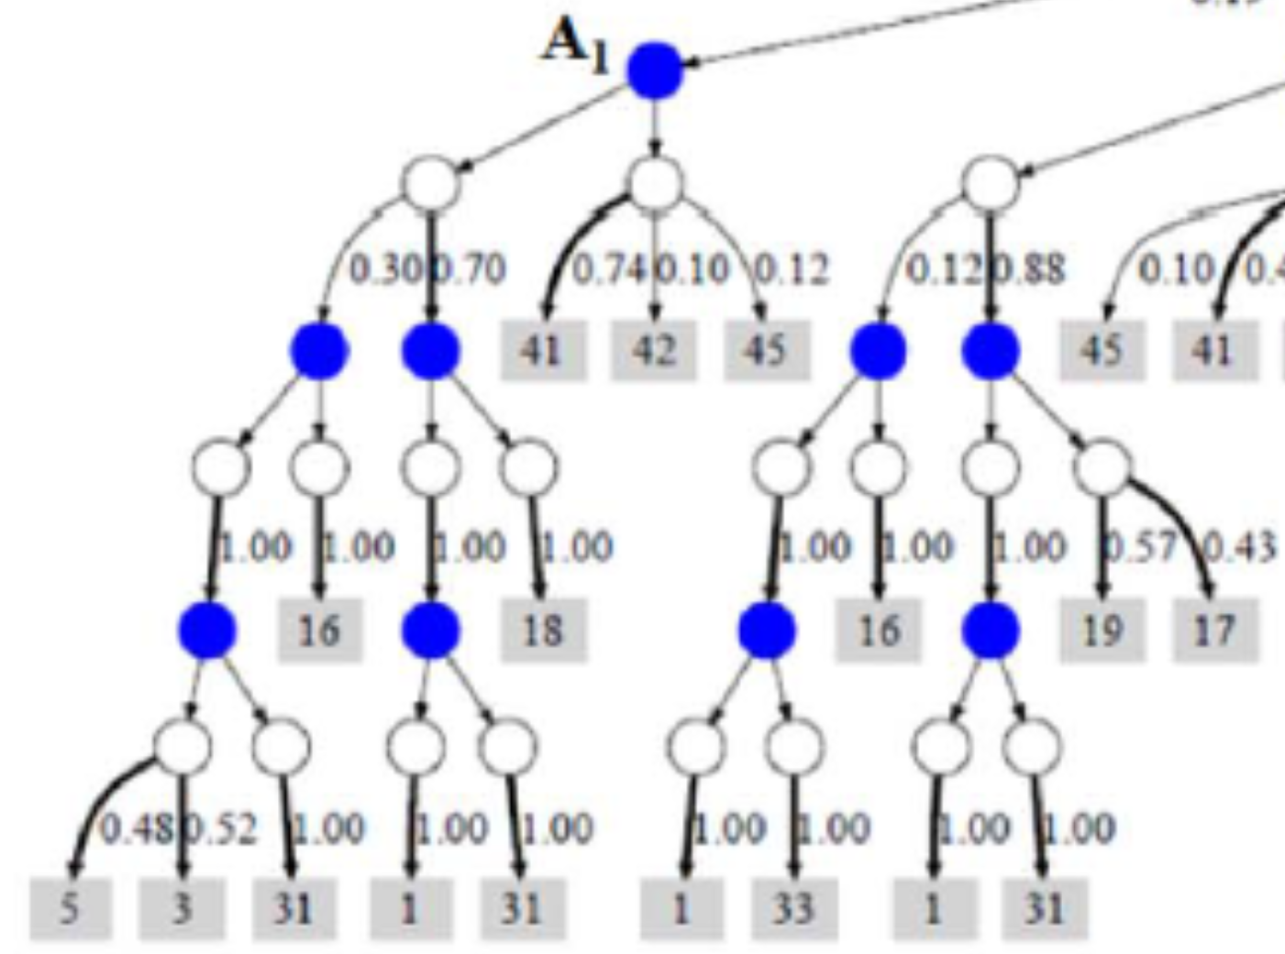

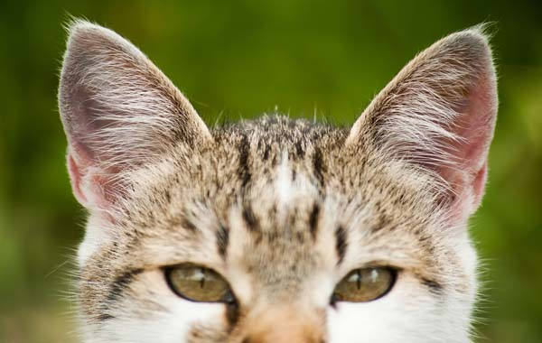
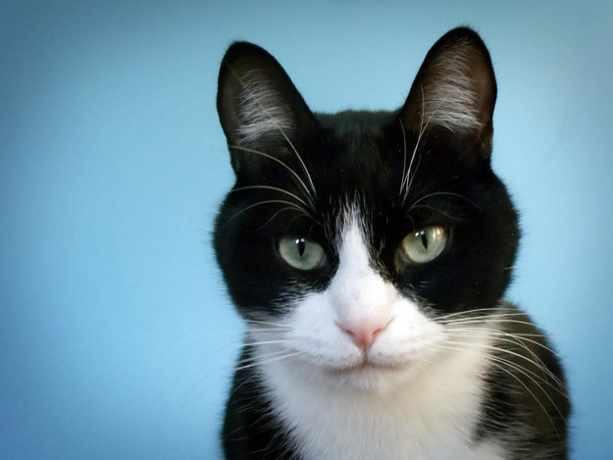
Today
©Spin South West
Why did you do that?
Why not something else?
When do you succeed?
When do you fail?
When can I trust you?
How do I correct an error?
Learning
Process
This is a cat
(p = .93)
©University Of Toronto
http://explainthatstuff.com
Training
Data
Learned
Function
Output
User with
a Task
Tomorrow
©Spin South West
I understand why
I understand why not
I know when you’ll succeed
I know when you’ll fail
I know when to trust you
I know why you erred
New
Learning
Process
This is a cat:
It has fur, whiskers, and claws.
It has this feature:
©University Of Toronto
Training
Data
Explainable Model
Explanation Interface
User with
a Task
Slide courtesy: David Gunning, DARPA XAI Program Manager

Slide 4
Learning Techniques (today)
Explainability
(notional)
Neural Nets
Graphical
Models
Deep
Learning
Tomorrow
Bayesian
Belief Nets
Ensemble
Methods
Today
Learning Performance
Learning Performance
SRL
Random
Forests
AOGs
CRFs
HBNs
Statistical
Models
MLNs
Decision
Trees
Markov Models
Explainability (notional)
SVMs
Explainability
Slide courtesy: David Gunning, DARPA XAI Program Manager

Slide 5
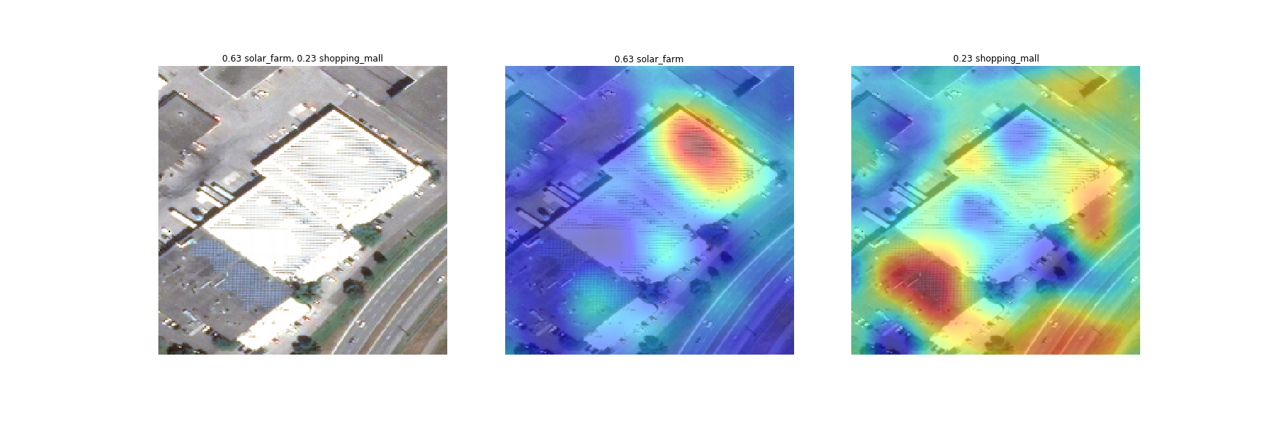
Why Do We Need Explainable AI
○ explain prediction
Neural network prediction:
solar farm: 63%, shopping mall: 23%
Slide courtesy: Kate Saenko, Boston University

Slide 6
Why Do We Need Explainable AI
○ explain prediction
Neural network prediction:
solar farm: 63%, shopping mall: 23%
Explanation for “solar farm”
Explanation for “shopping mall”
Slide courtesy: Kate Saenko, Boston University

Slide 7
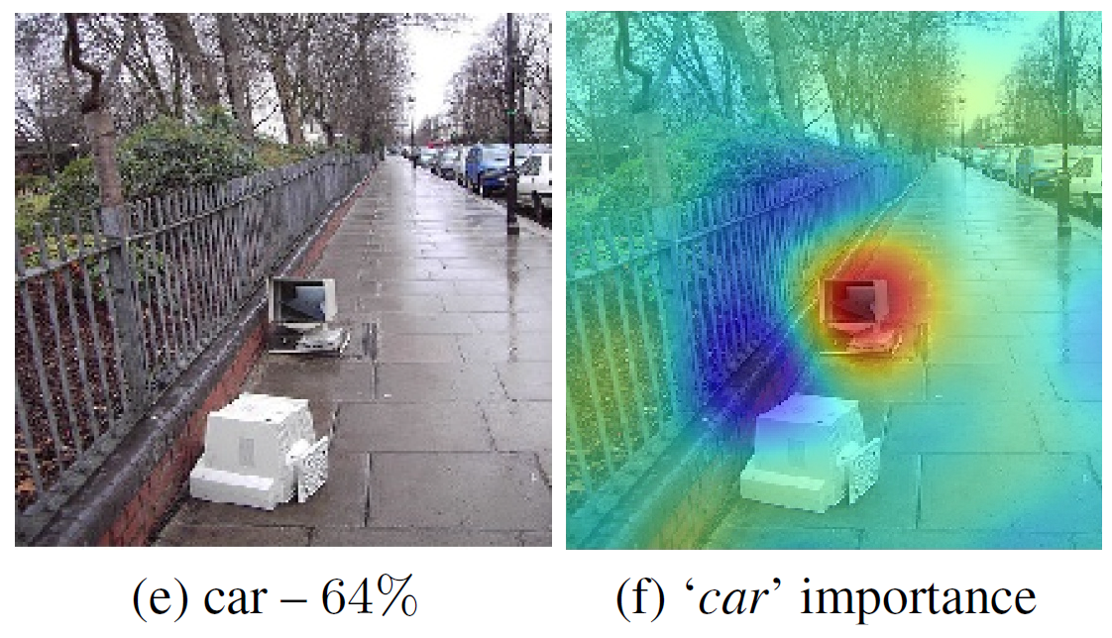
Why Do We Need Explainable AI
○ explain prediction
○ Improve the model
Why did the classifier predict “car”?
Prediction: “car” 64%
Slide courtesy: Kate Saenko, Boston University

Slide 8
Why Do We Need Explainable AI
○ explain prediction
○ Improve the model
Why did the classifier predict “car”? – correct but for wrong reasons!
Prediction: “car” 64%
Explanation for “car”
Cars parked
actual reason is a
monitor and street
context
Slide courtesy: Kate Saenko, Boston University

Slide 9
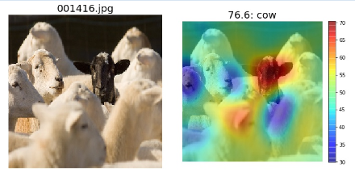
Why Do We Need Explainable AI
○ explain prediction
○ Improve the model
○ Discover bias
Why did the classifier predict “cow” (incorrect)?
Prediction: “cow” 76%
Slide courtesy: Kate Saenko, Boston University

Slide 10
Why Do We Need Explainable AI
○ explain prediction
○ Improve the model
○ Discover bias
Why did the classifier predict “cow” (incorrect)?
Prediction: “cow” 76%
MODEL BIAS:
most sheep are
white, so model
mistakes black
sheep for cows
Slide courtesy: Kate Saenko, Boston University

Slide 11
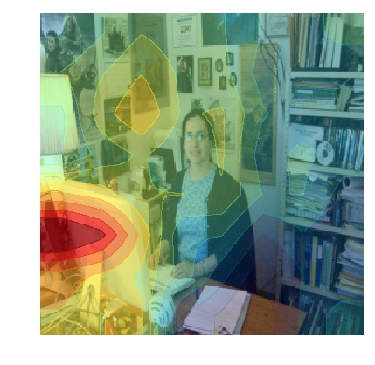
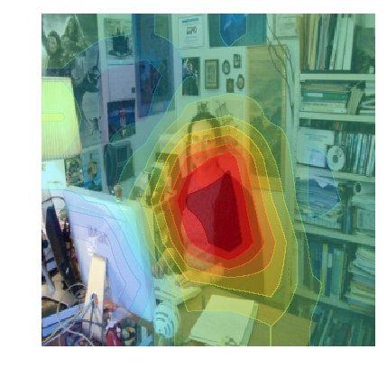
Why Do We Need Explainable AI
○ explain prediction
○ Improve the model
○ Discover bias
Wrong
Right for the Right Reasons
Baseline: A man sitting at a desk with a laptop computer.
Proposed Model: A woman sitting in front of a laptop computer.
Burns, Hendricks, et. al, Women Also Snowboard: Overcoming Bias in Captioning Models

Slide 12
Need for Explainability and Transparency in 3 Stages of AI Evolution
When AI is significantly weaker than humans and not yet readily deployable:
Goal of transparency and explanations is to identify the failure modes.
e.g., open-ended visual question answering (VQA), automated medical diagnosis etc.
When AI is at par with humans and reliably deployable:
Goal of transparency and explanations is to establish trust with users.
e.g., image classification on a set of categories trained on sufficient data
When AI is significantly stronger than humans:
Goal of transparency and explanations is machine teaching – a machine teaching a human how to make accurate predictions
e.g., chess or go playing bots
Slide motivated from - R Selvaraju, A Das, R Vedantam, M Cogswell, D Parikh, D Batra, “Grad-CAM: Why did you say that? Visual Explanations from Deep Networks via Gradient-based Localization”, ICCV 2017

Slide 13
Explainable AI: Different Schools of Thoughts
Occlusion Based Methods:
Activation/Gradient based methods:
Deconvolution based Methods:
Theory of Deep Learning

Slide 14
Introspection vs Justification/Post-hoc Rationalization
Introspection: Provides how a model determines its final output
e.g., This is an elephant because filter 2 and 84 has high activation
Justification: It explains why a decision is made.
e.g., This is an elephant because it has a trunk and two long teeth
Intuitively, a justification explains why a decision is good (or bad), but it may not do so by explaining exactly how it was made
Justification, many a times, make the user feel good than an introspection as introspection may not make “sufficient contact” with a given user (non-expert)
What makes an explanation good:
Simplicity (Bonawitz & Lombrozo 2012; Lombrozo 2007;), Clarity, Completeness, Consistency with prior beliefs (Pennington & Hastie 1993, Williams & Lombrozo 2013), Fidelity

Slide 15
Different Forms of Explanations
Visualizations
Textual justifications
Graphs, Networks, Algorithms, Computational Processes, Proofs
Hierarchies, Cause-effect relations

Slide 16
Activation/Gradient based methods

Slide 17
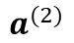
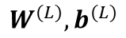
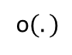
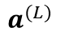
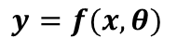
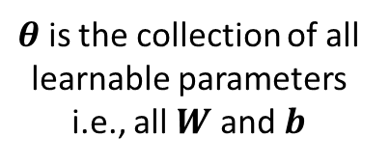
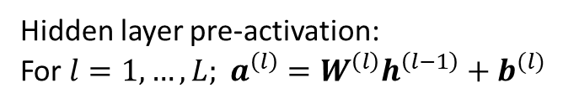
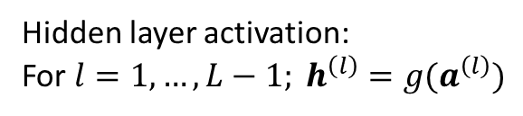
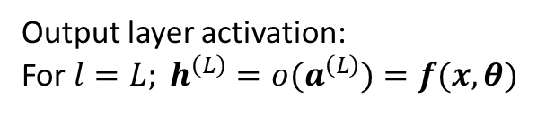
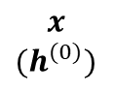
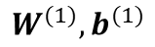
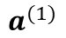
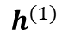
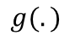

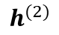
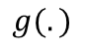
Forward Pass in a Nutshell
$θ$ is the collection of all learnable parameters i.e., all $W$ and $b$
$$x$$
$${(h}^{(0)})$$
$$W^{(1)},b^{(1)}$$
$$g(.)$$
$$W^{(2)},b^{(2)}$$
$$g(.)$$
$$W^{(L)},b^{(L)}$$
o$(.)$
$$y=f(x, θ)$$
$$a^{(1)}$$
$$h^{(1)}$$
$$a^{(2)}$$
$$h^{(2)}$$
$$a^{(L)}$$
Hidden layer pre-activation:
For $l=1,…,L; a^{\left(l\right)}=W^{\left(l\right)}h^{\left(l−1\right)}+b^{(l)}$
Hidden layer activation:
For $l=1,…,L−1; h^{\left(l\right)}={g(a}^{\left(l\right)})$
Output layer activation:
For $l=L; h^{\left(L\right)}={o(a}^{\left(L\right)})=f(x, θ)$

Slide 18
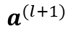
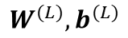
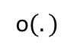
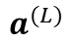
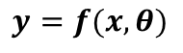
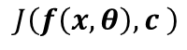
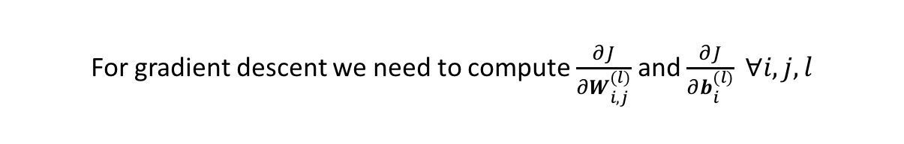
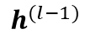
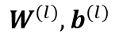
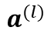
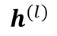
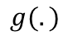
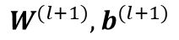
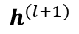
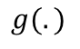
Backpropagation in a Nutshell
$$h^{(l−1)}$$
$$W^{(l)},b^{(l)}$$
$$g(.)$$
$$W^{(l+1)},b^{(l+1)}$$
$$g(.)$$
$$W^{(L)},b^{(L)}$$
o$(.)$
$$y=f(x, θ)$$
$$a^{(l)}$$
$$h^{(l)}$$
$$a^{(l+1)}$$
$$h^{(l+1)}$$
$$a^{(L)}$$
$$J\left(f\left(x, θ\right),c \right)$$
True class of the example
For gradient descent we need to compute $\frac{∂J}{∂W_{i,j}^{(l)}}$ and $\frac{∂J}{∂b_{i}^{(l)}} ∀i,j,l$
Backpropagation consists of intelligent use of the chain rule of differentiation for computation of these gradients

Slide 19
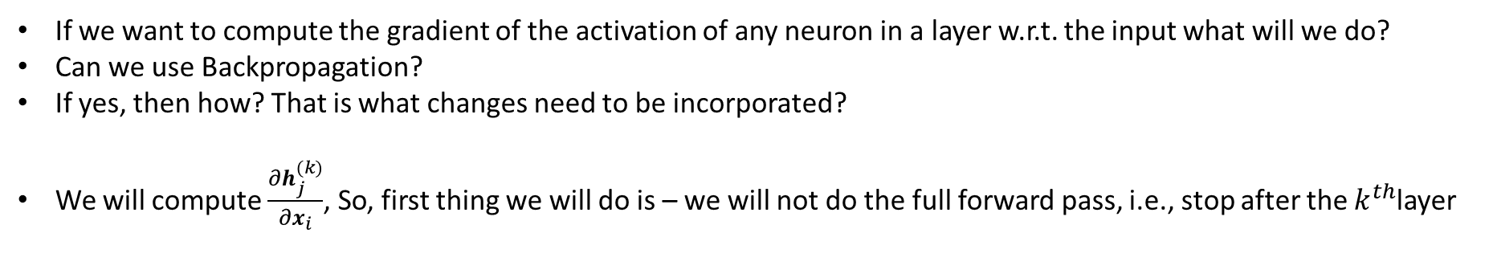
Backpropagation in a Nutshell
$$h^{(l−1)}$$
$$W^{(l)},b^{(l)}$$
$$g(.)$$
$$W^{(l+1)},b^{(l+1)}$$
$$g(.)$$
$$W^{(L)},b^{(L)}$$
o$(.)$
$$y=f(x, θ)$$
$$a^{(l)}$$
$$h^{(l)}$$
$$a^{(l+1)}$$
$$h^{(l+1)}$$
$$a^{(L)}$$
$$J\left(f\left(x, θ\right),c \right)$$
True class of the example
For gradient descent we need to compute $\frac{∂J}{∂W_{i,j}^{(l)}}$ and $\frac{∂J}{∂b_{i}^{(l)}} ∀i,j,l$
Backpropagation consists of intelligent use of the chain rule of differentiation for computation of these gradients
If we want to compute the gradient of the activation of any neuron in a layer w.r.t. the input what will we do?
Can we use Backpropagation?
If yes, then how? That is what changes need to be incorporated?
We will compute $\frac{∂h_{j}^{(k)}}{∂x_{i}}$, So, first thing we will do is – we will not do the full forward pass, i.e., stop after the $k^{th}$layer

Slide 20


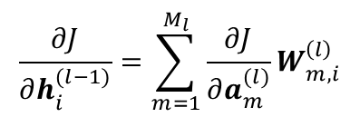
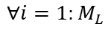

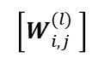
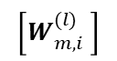
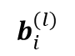
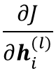















Backpropagation in a Nutshell
$$\left[W_{m,i}^{(l)} \right]$$
$$\frac{∂J}{∂W_{i,j}^{(l)}}$$
$$\frac{∂J}{∂a_{i}^{(l)}}$$
$$b_{i}^{(l)}$$
$$\left[W_{i,j}^{(l)} \right]$$
$$×$$
$$h_{j}^{\left(l−1\right)}$$
$$×$$
$$+$$
$$a_{i}^{(l)}$$
$$g(.)$$
$$h_{j}^{\left(l\right)}$$
$$\frac{∂J}{∂a_{i}^{(l)}}=\frac{∂J}{∂h_{i}^{(l)}}g′\left(a_{i}^{(l)}\right)$$
… (3)
$$∀i=1:M_{L}$$
$$\frac{∂J}{∂b_{i}^{(l)}}=\frac{∂J}{∂a_{i}^{(l)}}$$
… (2)
$$g′(.)$$
$$\frac{∂J}{∂W_{i,j}^{(l)}}=\frac{∂J}{∂a_{i}^{(l)}}h_{j}^{\left(l−1\right)}$$
… (1)
$$\frac{∂J}{∂h_{i}^{(l−1)}}$$
$$×$$
$$\frac{∂J}{∂a_{i}^{(l)}}$$
$$\frac{∂J}{∂h_{i}^{(l)}}$$
$$\frac{∂J}{∂h_{i}^{(l−1)}}=\sum_{m=1}^{M_{l}}{\frac{∂J}{∂a_{m}^{(l)}}}W_{m,i}^{\left(l\right)}$$
and
$$∀i=1:M_{L}$$
$$×$$
… (4)
$$+$$

Slide 21

Backpropagation in a Nutshell
The very first thing to compute is $\frac{∂h_{j}^{(k)}}{∂h_{j}^{(k)}}$ which is 1 and backpropagate this all the way to the input. (Note, derivatives of $h_{j}^{(k)}$ w.r.t. all other neurons in the $k^{th}$layer are 0)
$$\left[W_{m,i}^{(l)} \right]$$
$$\frac{∂J}{∂W_{i,j}^{(l)}}$$
$$\frac{∂J}{∂a_{i}^{(l)}}$$
$$b_{i}^{(l)}$$
$$\left[W_{i,j}^{(l)} \right]$$
$$×$$
$$h_{j}^{\left(l−1\right)}$$
$$×$$
$$+$$
$$a_{i}^{(l)}$$
$$g(.)$$
$$h_{j}^{\left(l\right)}$$
$$\frac{∂J}{∂a_{i}^{(l)}}=\frac{∂J}{∂h_{i}^{(l)}}g′\left(a_{i}^{(l)}\right)$$
… (3)
$$∀i=1:M_{L}$$
$$\frac{∂J}{∂b_{i}^{(l)}}=\frac{∂J}{∂a_{i}^{(l)}}$$
… (2)
$$g′(.)$$
$$\frac{∂J}{∂W_{i,j}^{(l)}}=\frac{∂J}{∂a_{i}^{(l)}}h_{j}^{\left(l−1\right)}$$
… (1)
$$\frac{∂J}{∂h_{i}^{(l−1)}}$$
$$×$$
$$\frac{∂J}{∂a_{i}^{(l)}}$$
$$\frac{∂J}{∂h_{i}^{(l)}}$$
$$\frac{∂J}{∂h_{i}^{(l−1)}}=\sum_{m=1}^{M_{l}}{\frac{∂J}{∂a_{m}^{(l)}}}W_{m,i}^{\left(l\right)}$$
and
$$∀i=1:M_{L}$$
$$×$$
… (4)
$$+$$

Slide 22











Backpropagation in a Nutshell
The very first thing to compute is $\frac{∂h_{j}^{(k)}}{∂h_{j}^{(k)}}$ which is 1 and backpropagate this all the way to the input. (Note, derivatives of $h_{j}^{(k)}$ w.r.t. all other neurons in the $k^{th}$layer are 0)
$$\left[W_{m,i}^{(l)} \right]$$
$$\frac{∂h_{j}^{(k)}}{∂W_{i,j}^{(l)}}$$
$$\frac{∂h_{j}^{(k)}}{∂a_{i}^{(l)}}$$
$$b_{i}^{(l)}$$
$$\left[W_{i,j}^{(l)} \right]$$
$$×$$
Then, for all $0≤l≤k$
$$h_{j}^{\left(l−1\right)}$$
$$×$$
$$+$$
$$a_{i}^{(l)}$$
$$g(.)$$
$$h_{j}^{\left(l\right)}$$
(Notice the change from $J$ to $h_{j}^{(k)}$)
$$\frac{∂h_{j}^{(k)}}{∂a_{i}^{(l)}}=\frac{∂h_{j}^{(k)}}{∂h_{i}^{(l)}}g′\left(a_{i}^{(l)}\right)$$
… (3)
$$∀i=1:M_{L}$$
$$\frac{∂h_{j}^{(k)}}{∂b_{i}^{(l)}}=\frac{∂h_{j}^{(k)}}{∂a_{i}^{(l)}}$$
… (2)
$$g′(.)$$
$$\frac{∂h_{j}^{(k)}}{∂W_{i,j}^{(l)}}=\frac{∂h_{j}^{(k)}}{∂a_{i}^{(l)}}h_{j}^{\left(l−1\right)}$$
… (1)
$$\frac{∂h_{j}^{(k)}}{∂h_{i}^{(l−1)}}$$
$$×$$
$$\frac{∂h_{j}^{(k)}}{∂a_{i}^{(l)}}$$
$$\frac{∂h_{j}^{(k)}}{∂h_{i}^{(l)}}$$
$$\frac{∂h_{j}^{(k)}}{∂h_{i}^{(l−1)}}=\sum_{m=1}^{M_{l}}{\frac{∂h_{j}^{(k)}}{∂a_{m}^{(l)}}}W_{m,i}^{\left(l\right)}$$
and
$$∀i=1:M_{L}$$
$$×$$
… (4)
$$+$$

Slide 23



How Does It Help?
Helps to understand what excites a neuron the most. That is the interpretation of the gradient of a neuron activation value with respect to the input
A high gradient of an output neuron activation value (i.e., classification score) w.r.t. a certain input pixel implies a small change (perturbation) of that input pixel has a large effect on the classification score represented by that output neuron
Simonyan, Vedaldi, and Zisserman, "Deep Inside Convolutional Networks: Visualising Image Classification Models and Saliency Maps", ICLR Workshop 2014.

Slide 24


How Does It Help?
Helps to understand what sort of images generate maximum score (probability) for a particular class
Use backpropagation to get such an image (not a network i.e., weights of a network) for a particular class
$\arg{\max_{I}{S_{c}\left(I\right)−λ{\left|\left|I\right|\right|}_{2}^{2}}}$ -- Looking for an image $I$ where $S_{c}$ is the score of class $c$
The regularization term restricts the image to have a small number of pixels having very high intensities (Will see different variations in later slides)
"One goose is good, but 10 goose is much more likely goose" - Andrej Karpathy.
Simonyan, Vedaldi, and Zisserman, "Deep Inside Convolutional Networks: Visualising Image Classification Models and Saliency Maps", ICLR Workshop 2014.

Slide 25

Playing with the Regularizer
L-2 regularization (Same as previous work) [Suppressing high amplitude]
Gaussian blur: Images produced by gradient ascent tend to have lots of high frequency information. A useful regularization is to use blur (regularly after a few steps of optimization) [Suppressing high frequency]
Clipping stray pixels with small gradient or small intensities: This will stop stray pixels (possibly not belonging to an object as a whole), to contribute in whatever small way they can to ultimately raise the score
Yosinski, Clune, Nguyen, Fuchs, and Lipson, “Understanding Neural Networks Through Deep Visualization", ICML DL Workshop 2014

Slide 26

Playing with the Regularizer
The authors also showed results for high scores of intermediate (hidden) neurons and not only for output neurons
Yosinski, Clune, Nguyen, Fuchs, and Lipson, “Understanding Neural Networks Through Deep Visualization", ICML DL Workshop 2014

Slide 27

Playing with the Regularizer
The authors also showed results for high scores of intermediate (hidden) neurons and not only for output neurons
Yosinski, Clune, Nguyen, Fuchs, and Lipson, “Understanding Neural Networks Through Deep Visualization", ICML DL Workshop 2014

Slide 28
Playing with the Regularizer
A regularizer is better if it helps to produce an image which not only excites a neuron to the maximum but also is realistic to look at
Intuitively, a good regularizer helps the system by telling it apriori what a natural image looks like. This prior information helps the system to search in the domain of natural images
Till now, hand designed prior/regularizer is used
How about incorporating good natural image priors that is learned from natural images?
A good generator, thus can be a good prior

Slide 29


Learning Natural Image Generator
Learns to generate image from already learned features (Inverse problem fc6 → image)
3 Loss terms
How close is the generated image to the original image
How close is the (vgg) features of the generated image and of the original image
How good the generated image can fool a discriminator
Dosovitskiy, and Brox, “Generating Images with Perceptual Similarity Metrics based on Deep Networks", NIPS 2016

Slide 30

Learning Natural Image Generator
Dosovitskiy, and Brox, “Generating Images with Perceptual Similarity Metrics based on Deep Networks", NIPS 2016

Slide 31





Use Learned Generator as Prior
Take the trained generator from the previous work (fc6 → image), say $G_{l},l$ is the layer from where the feature to be inverted is taken
Keeping $G$ fixed, the following optimization problem tries to change the values of the input feature from layer $l,$ so that it produces high activation on a target neuron $h$ in another network $\hat{y_{l}}=\arg{\max_{y^{l}}{(Φ_{h}\left(G_{l}\left(y^{l}\right)\right)−λ||y^{l}||)}}$
$$Φ_{h}$$
$$y^{l}$$
Nguyen, Dosovitskiy, Yosinski , Brox, Clune, “Synthesizing the Preferred Inputs for Neurons in Neural Networks via Deep Generator Networks", NIPS 2016.
$$G_{l}$$

Slide 32

Use Learned Generator as Prior
Nguyen, Dosovitskiy, Yosinski , Brox, Clune, “Synthesizing the Preferred Inputs for Neurons in Neural Networks via Deep Generator Networks", NIPS 2016.

Slide 33

Use Learned Generator as Prior
Nguyen, Dosovitskiy, Yosinski , Brox, Clune, “Synthesizing the Preferred Inputs for Neurons in Neural Networks via Deep Generator Networks", NIPS 2016.

Slide 34








Now AM will stand for Activation Map (not Activation Maximization)
c
$$F_{1}$$
$$F_{2}$$
c
c
$$F_{n}$$
$$F_{k}=\frac{1}{Z}\sum_{x,y}{f_{k}(x,y)}$$
$$S_{c}=\sum_{k}{W_{k}^{c}F_{k}}$$
→ Average Pooling
→ Score of class $c$,
$$S_{c}=\sum_{k}{W_{k}^{c}F_{k}}=\sum_{k}{W_{k}^{c}}\frac{1}{Z}\sum_{x,y}{f_{k}(x,y)}=\frac{1}{Z}\sum_{x,y}{\sum_{k}{W_{k}^{c}f_{k}\left(x,y\right)}=\frac{1}{Z}\sum_{x,y}{M_{c}(x,y)}}$$
Where $M_{c}(x,y)=\sum_{k}{W_{k}^{c}f_{k}\left(x,y\right)}$
(First interpretation) Take simple average of activations in a channel and then take weighted average
(Second interpretation) Take weighted average across channels for activations at fixed (x,y) and then take simple average (equivalent to sum)
B. Zhou, A. Khosla, A Lapedriza, A Oliva, A Torralba, “Learning Deep Features for Discriminative Localization”, CVPR 2016

Slide 35


Now AM will stand for Activation Map (not Activation Maximization)
c
$$F_{1}$$
$$F_{2}$$
c
c
$$F_{n}$$
$$S_{c}=\frac{1}{Z}\sum_{x,y}{M_{c}(x,y)}$$
B. Zhou, A. Khosla, A Lapedriza, A Oliva, A Torralba, “Learning Deep Features for Discriminative Localization”, CVPR 2016

Slide 36


Class Activation Map (CAM)
B. Zhou, A. Khosla, A Lapedriza, A Oliva, A Torralba, “Learning Deep Features for Discriminative Localization”, CVPR 2016

Slide 37

Gradient Weighted Class Activation Map (Grad-CAM)
Uses gradient information too to produce localization map of important regions in the image for each class
Grad-CAM is a generalization of CAM and applicable to any CNN-based architecture
Grad-CAM has two important properties – i) Class Discriminative and ii) High-Resolution
R Selvaraju, A Das, R Vedantam, M Cogswell, D Parikh, D Batra, “Grad-CAM: Why did you say that? Visual Explanations from Deep Networks via Gradient-based Localization”, ICCV 2017

Slide 38


Gradient Weighted Class Activation Map (Grad-CAM)
Remember CAM - $M_{c}(x,y)=\sum_{k}{W_{k}^{c}f_{k}\left(x,y\right)}$
Two major changes
Use gradient information to weigh the activation $\sum_{k}{α_{k}^{c}f_{k}\left(x,y\right)}$ where, $α_{k}^{c}=\frac{1}{Z}\sum_{x,y}{\frac{∂S_{c}}{{∂f}_{k}\left(x,y\right)}}$
Only positive influence is considered $M_{c}(x,y)=ReLU(\sum_{k}{α_{k}^{c}f_{k}\left(x,y\right)}$)
They also combined Grad-CAM with guided backpropagation
R Selvaraju, A Das, R Vedantam, M Cogswell, D Parikh, D Batra, “Grad-CAM: Why did you say that? Visual Explanations from Deep Networks via Gradient-based Localization”, ICCV 2017

Slide 39

Grad-CAM as Generalization of CAM
Remember CAM - $M_{c}(x,y)=\sum_{k}{W_{k}^{c}f_{k}\left(x,y\right)}$
Remember Grad-CAM (w/o ReLU) -$L_{c}(x,y)=\sum_{k}{α_{k}^{c}f_{k}\left(x,y\right)}$ , where $α_{k}^{c}=\frac{1}{Z}\sum_{x,y}{\frac{∂S_{c}}{{∂f}_{k}\left(x,y\right)}}$
For CAM like architecture (conv-layers -> GAP -> fc layer with softmax), it can be shown that $α_{k}^{c}∝W_{k}^{c}$
Proof in next slide
R Selvaraju, A Das, R Vedantam, M Cogswell, D Parikh, D Batra, “Grad-CAM: Why did you say that? Visual Explanations from Deep Networks via Gradient-based Localization”, ICCV 2017

Slide 40

Grad-CAM as Generalization of CAM
In CAM, average pooling results $F_{k}=\frac{1}{Z}\sum_{x,y}{f_{k}(x,y)}$ … (A)
In CAM, the final score $S_{c}=\sum_{k}{W_{k}^{c}F_{k}}$ … (B)
Taking the gradient of the score for class $c$, w.r.t. the (average pooled) feature map $F_{k}$, we get $\frac{∂S_{c}}{∂F_{k}}=\frac{{∂S_{c}}/{∂f_{k}(x,y)}}{{∂F_{k}}/{∂f_{k}(x,y)}}$
$W_{k}^{c}=\frac{∂S_{C}}{∂f_{k}(x,y)}Z$ … (C)
Use relation (B)
Use relation (A)
R Selvaraju, A Das, R Vedantam, M Cogswell, D Parikh, D Batra, “Grad-CAM: Why did you say that? Visual Explanations from Deep Networks via Gradient-based Localization”, ICCV 2017

Slide 41




Grad-CAM as Generalization of CAM
$W_{k}^{c}=Z\frac{∂S_{C}}{∂f_{k}(x,y)}$ … (C)
Summing both sides over all pixels $(x,y)$, we get
$\sum_{x,y}{W_{k}^{c}}= \sum_{x,y}{Z\frac{∂S_{C}}{∂f_{k}(x,y)}}$
$$⇒ZW_{k}^{c}=Z\sum_{x,y}{\frac{∂S_{C}}{∂f_{k}(x,y)}}$$
$$⇒W_{k}^{c}=\sum_{x,y}{\frac{∂S_{C}}{∂f_{k}(x,y)}}=Zα_{k}^{c} [As, α_{k}^{c}=\frac{1}{Z}\sum_{x,y}{\frac{∂S_{C}}{∂f_{k}(x,y)}}]$$
$$⇒α_{k}^{c}∝W_{k}^{c}$$
R Selvaraju, A Das, R Vedantam, M Cogswell, D Parikh, D Batra, “Grad-CAM: Why did you say that? Visual Explanations from Deep Networks via Gradient-based Localization”, ICCV 2017

Slide 42

Seemingly Unreasonable Predictions have Reasonable Explanations
R Selvaraju, A Das, R Vedantam, M Cogswell, D Parikh, D Batra, “Grad-CAM: Why did you say that? Visual Explanations from Deep Networks via Gradient-based Localization”, ICCV 2017

Slide 43

Evaluating Trust
R Selvaraju, A Das, R Vedantam, M Cogswell, D Parikh, D Batra, “Grad-CAM: Why did you say that? Visual Explanations from Deep Networks via Gradient-based Localization”, ICCV 2017

Slide 44



Occlusion Based Methods
car
Independent search
car
Joint Search
M Zeiler, R Fergus, “Visualizing and Understanding Convolutional Networks”, ECCV 2014

Slide 45






RISE
P[shark]
shark
RISE: Randomized Input Sampling for Explanation of Black-box Models, Petsiuk, Das, Saenko, BMVC 2018
Slide Courtesey: Kate Saenko, Boston University

Slide 46



Explanations for Different Categories
Explanation for Sheep
Explanation for Cow
RISE: Randomized Input Sampling for Explanation of Black-box Models, Petsiuk, Das, Saenko, BMVC 2018
Slide Courtesey: Kate Saenko, Boston University

Slide 47


Localization-based metrics
wind farm
Good explanations don’t have to align well with human-labeled ground truth.
recreational facility
MoDL, NCVPRIPG 2019| Explainibility in AI(c) Abir Das
Slide Courtesey: Kate Saenko, Boston University

Slide 48


Causal metrics
Deletion
Insertion
Slide Courtesey: Kate Saenko, Boston University

Slide 49


Evaluation
Causal metrics on ImageNet dataset
Localization metric (pointing game) on MSCOCO and Pascal VOC

Slide 50
Bias in AI

Slide 51

Slide courtesy: Aaron Roth

Slide 52
Bias
Definition of Bias in computer systems from “Bias in Computer Systems” by Batya Friedman (1996). – “computer systems that systematically and unfairly discriminate against certain individuals or groups of individuals in favor of others”.
Example (from the same paper): For an automated credit advisor
System denying credits to individuals with consistently poor payment records is not a biased system.
But, systematically denying to individuals with ethnic surnames is unfair discrimination as that is not a relevant criterion to asses credit rating.

Slide 53
Bias
unfair discrimination alone does not give rise to bias unless it occurs systematically.
Imagine a credit applicant having ethnic surname. If a random glitch in the system mistakenly copies some credit information from another person and that lowers the applicant’s rating. While this applicant experiences unfair discrimination resulting from this random glitch, the applicant could have been anybody.
systematic discrimination does not establish bias unless it is joined with an unfair outcome
Lets consider a car tracking system. Due to imprecision in calculation if the car’s position gets wrong then its an error but does not bring about an unfair outcome.

Slide 54
Cause of Unfairness
Bias encoded in Data.
“ML techniques are designed to fit data and so will naturally replicate any bias already present in the data. There is no reason to expect them to remove existing bias.”
Minimizing Average Error Fits Majority Populations.
“A ML algorithm cannot simultaneously fit to all populations optimally, it will fit the majority population. The fit to majority population is more important to overall error than the fit to minority population.”
The need to Explore.
“We only observe whether an inmate will recidivate if we release him. We only observe the efficacy of a drug on patients to whom it is assigned.”
A. Chouldechov, A. Roth, “The Frontiers of Fairness in Machine Learning”, 2018

Slide 55

Example of AI (Un)Fairness: COMPASS
Criminal justice: recidivism algorithms (COMPAS)
Predicting if a defendant should receive bail
Unbalanced false positive rates: more likely to wrongly deny a black person bail
https://www.propublica.org/article/machine-bias-risk-assessments-in-criminal-sentencing

Slide 56

Example of AI (Un)Fairness
Bias found in word embeddings (Bolukbasi et. Al. 2016)
Examined word embeddings (word2vec) trained on Google News
Represent each word with high-dimensional vector
Vector arithmetic: found analogies like
Paris-France=London-England
Man-woman=programmer-homemaker=surgeon -nurse
The good news: word embeddings learn so well
The bad news: Sometimes too well
Our chatbots should be less biased than we are
Bolukbasi et. al. Man is to Computer Programmer as Woman is to Homemaker? Debiasing Word Embeddings, NIPS 2016

Slide 57

Example of AI (Un)Fairness
Bolukbasi et. al. Man is to Computer Programmer as Woman is to Homemaker? Debiasing Word Embeddings, NIPS 2016

Slide 58



Women Also Snowboard: Overcoming Bias in Captioning Models
Lisa Anne Hendricks*¹, Kaylee Burns *¹ Kate Saenko², Trevor Darrell¹, Anna Rohrbach¹ ¹ UC Berkeley ² Boston University

Slide 59
Motivation
Bias can aﬀect predictions in diﬀerent ways…
CS60010 / Deep Learning | Explainibility and Bias (c) Abir Das

Slide 60

Motivation
Captioning models may make errors due to bias:
Wrong
evidence
Model: A man sitting at a desk with a laptop computer.
CS60010 / Deep Learning | Explainibility and Bias (c) Abir Das

Slide 61

Motivation
Captioning models may base correct prediction on wrong evidence:
evidence
Right for the Wrong Reasons
Model: A man holding a tennis racquet on a tennis court.
CS60010 / Deep Learning | Explainibility and Bias (c) Abir Das

Slide 62

Motivation
Captioning models “hallucinate” objects based on context
What’s worse, performance metrics fail to capture this
CS60010 / Deep Learning | Explainibility and Bias (c) Abir Das

Slide 63


Contribution #1: improve gender bias
Motivation: baseline models exaggerate imbalances in training data.
Ground truth captions
Generated captions
CS60010 / Deep Learning | Explainibility and Bias (c) Abir Das

Slide 64

Contribution #2: use appropriate evidence
Predict caption words based on appropriate evidence:
Right for the Wrong Reasons
Right for the Right Reasons
Baseline: A man holding a tennis racquet on a tennis court.
Our Model: A man holding a tennis racquet on a tennis court.
CS60010 / Deep Learning | Explainibility and Bias (c) Abir Das

Slide 65
Contributions
Equalizer model builds off of existing vision and language models and consists of two losses:
Appearance Confusion Loss. Encourages the model to be confused when gender evidence is occluded.
Confident Loss. Encourages the model to be confident when gender evidence is present.
Equalizer improves over baselines by:
Decreasing gender misclassification.
Generating sentences with gender distribution more aligned with ground truth.
Is right for the right reasons: looks at people when describing gender.
CS60010 / Deep Learning | Explainibility and Bias (c) Abir Das
Women Also Snowboard: Overcoming Bias in Captioning Models

Slide 66

Baseline Description Framework
CS60010 / Deep Learning | Explainibility and Bias (c) Abir Das
Women Also Snowboard: Overcoming Bias in Captioning Models

Slide 67


Approach: Equalizer
A man …
$I^{′}=I⨀M$ where, M is a mask where the values are 1 for pixels which should not contribute to a gender decision and 0 for pixels which are appropriate to consider when determining gender.
A ? …
CS60010 / Deep Learning | Explainibility and Bias (c) Abir Das

Slide 68

Approach: Equalizer
CS60010 / Deep Learning | Explainibility and Bias (c) Abir Das

Slide 69




Approach: Equalizer
A Confident Loss on images with men or women
An Appearance Confusion Loss on images where men and women are blocked out
CS60010 / Deep Learning | Explainibility and Bias (c) Abir Das

Slide 70
Approach: Equalizer
A Confident Loss on images with men or women
An Appearance Confusion Loss on images where men and women are blocked out
CS60010 / Deep Learning | Explainibility and Bias (c) Abir Das

Slide 71



Qualitative Examples
Baseline
UpWeight
Equalizer
A man walking a dog on a leash.
A man and a dog are in the snow.
A person walking a dog on a leash.
CS60010 / Deep Learning | Explainibility and Bias (c) Abir Das

Slide 72
Thank You

